Slide 1
Ampersand with EFA
AN automated way to restore system invariants

Slide 2

Presentation Summary
INTRODUCTION
Ampersand System
EFA (ECA For Ampersand)
SOFTWARE IMPLEMENTATION
Design Flow
Code Generation
Abstraction Barriers, Data types, Kinds
Testing for Properties
TESTING
Module and System testing
MySQL Testing

Slide 3
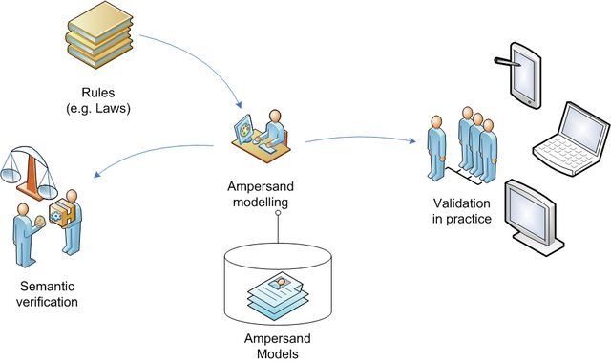
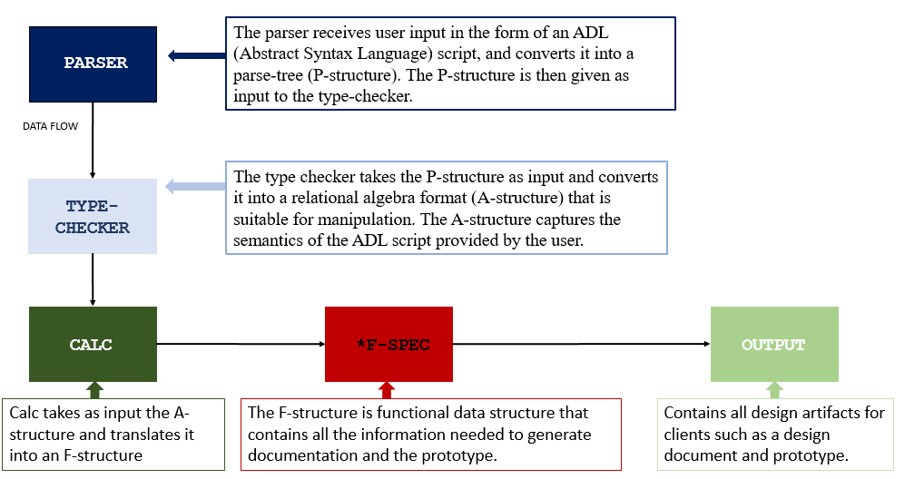
The Ampersand System

Slide 4

EFA (ECA For Ampersand)
Automatically correct system violations
Provable correctness
Testing for AMBRR algorithm (when AMBRR becomes complete)

Slide 5
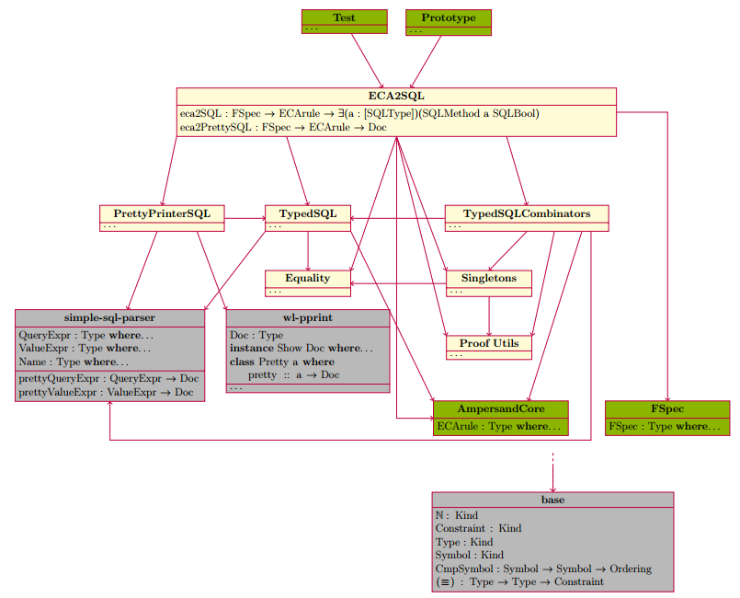
An Overview of EFA

Slide 6
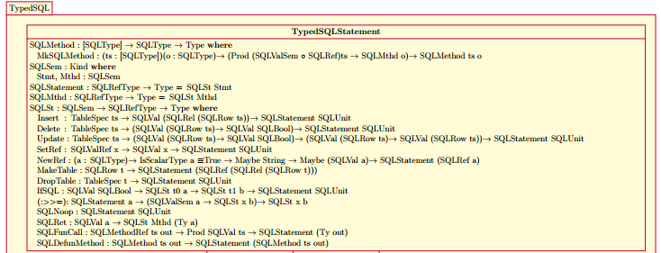
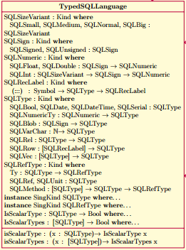
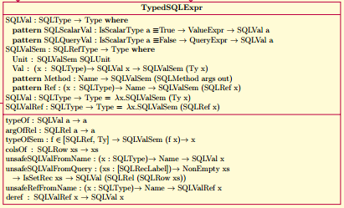
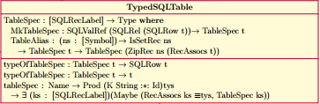

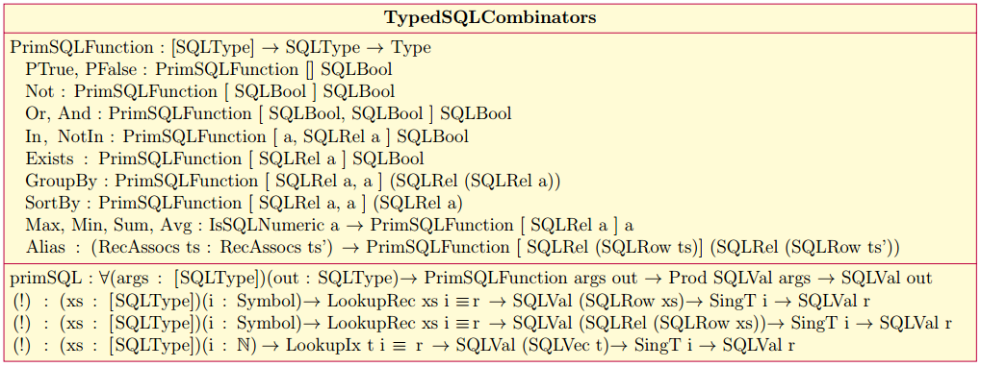
Code Generation

Slide 7



How it works.. And Why it is correct.
Source Code: Haskell
Proposition as Types
Type Level Modeling
Dependent Types
Abstraction Barriers

Slide 8

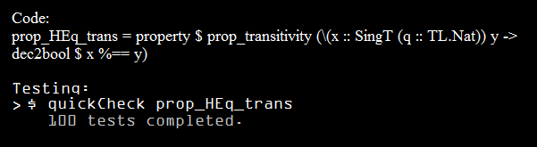

Testing for Properties
Transitive Property: if a=b, b=c, then a = c

Slide 9
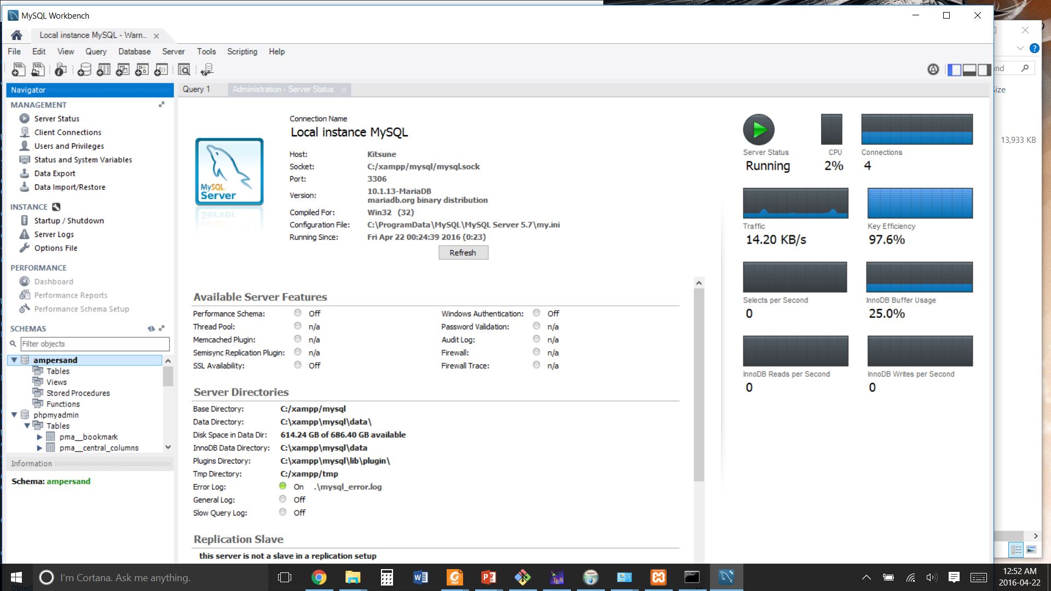
SQL Database Checking Using Workbench
Ampersand
ECA { ecaTriggr = On Ins rel_assignmentStarted_Assignment_Assignment , ecaDelta = vio_Delta_Assignment_Assignment ,
ecaAction = Do Ins {<things that need to be inserted>})]
ecaNum = 29 }
EFA
ON On {eSrt = Ins, eDcl = assignmentStarted[Assignment*Assignment]} INTO Delta[Assignment*Assignment] DO
INSERT INTO Isn{detyp=Assignment}
SELECT FROM (Delta;Delta~ /\ I[Assignment]) - I[Assignment] \/ (Delta~;Delta /\ I[Assignment]) - I[Assignment]}

Slide 10
References
Oracle Corporation. MySQL 5.7 Reference Manual.
D.M. Weiss D.L. Parnas, P.C. Clements. The modular structure of complex systems. Proceeding ICSE ’84: Proceedings of the 7th international, conference on Software engineering, 1984. Richard A. Eisenberg and Stephanie Weirich. Dependently typed programming with singletons. SIGPLAN Not., 47(12):117–130, September 2012.
Stef Joosten. Deriving Functional Specifications from Business Requirements with Ampersand. CiteSeer, 2007.
Daan Leijen. wl-pprint package. https://hackage.haskell.org/package/wl-pprint-1.2. Accessed: 2016-02-28.
Sam Lindley and Conor McBride. Hasochism: The pleasure and pain of dependently typed haskell programming. SIGPLAN Not., 48(12):81–92, September 2013.
A. Andreas Norell U., Danielsson N. A. The Agda Wiki. http://wiki.portal.chalmers.se/agda/pmwiki.php. Accessed: 2016-02-28.
Oracle. Mysql reference manual. https://dev.mysql.com/doc/refman/5.7/en/. Accessed: 2016-02-28.
The University Court of the University of Glasgow. The Glorious Glasgow Haskell Compilation System User’s Guide. Accessed: 2016-02-29.
D.L. Parnas. On the criteria to ne used in decomposing systems into modules. Communications of the ACM, 1972.
Tim Sheard and Simon Peyton Jones. Template meta-programming for haskell. SIGPLAN Not., 37(12):60–75, December 2002.
Wouter Swierstra. Data types la carte. Cambridge University Press, 2008. 24
Philip Wadler. Propositions as types. Communications of the AC, 58(12):7584, 2015.
Jake Wheat. simple-sql-parser. https://hackage.haskell.org/package/simple-sql-parser-0.4.1. Accessed: 2016-02-28.
Brent A. Yorgey, Stephanie Weirich, Julien Cretin, Simon Peyton Jones, Dimitrios Vytiniotis, and Jos´e Pedro Magalh˜aes. Giving haskell a promotion. In Proceedings of the 8th ACM SIGPLAN Workshop on Types in Language Design and Implementation, TLDI ’12, pages 53–66, New York, NY, USA, 2012. ACM

